Slide 1

AWS Glue
AWS Glue is a fully managed ETL (extract, transform, and load) service that makes it simple and cost-effective to categorize your data, clean it, enrich it, and move it reliably between various data stores. AWS Glue simplifies and automates the difficult and time consuming tasks of data discovery, conversion mapping, and job scheduling so you can focus more of your time querying and analyzing your data

Slide 2
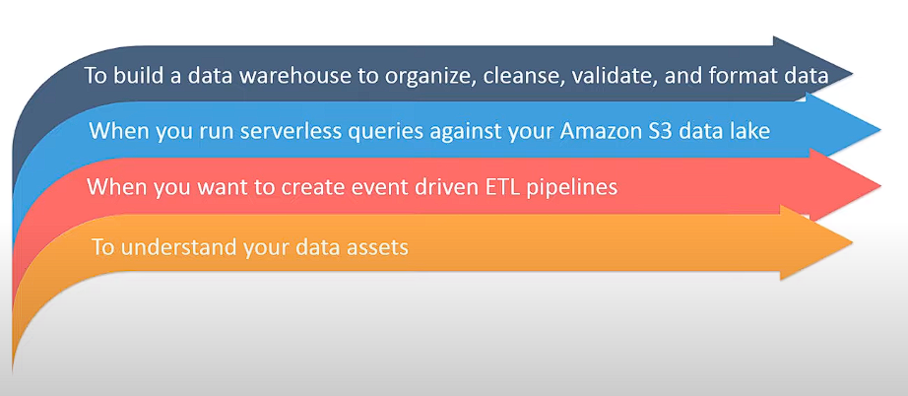
AWS Glue Usage
You can use AWS Glue to organize, cleanse, validate, and format data for storage in a data warehouse or data lake.
You can transform and move AWS Cloud data into your data store.
You can also load data from disparate static or streaming data sources into your data warehouse or data lake for regular reporting and analysis.
By storing data in a data warehouse or data lake, you integrate information from different parts of your business and provide a common source of data for decision making.

Slide 3
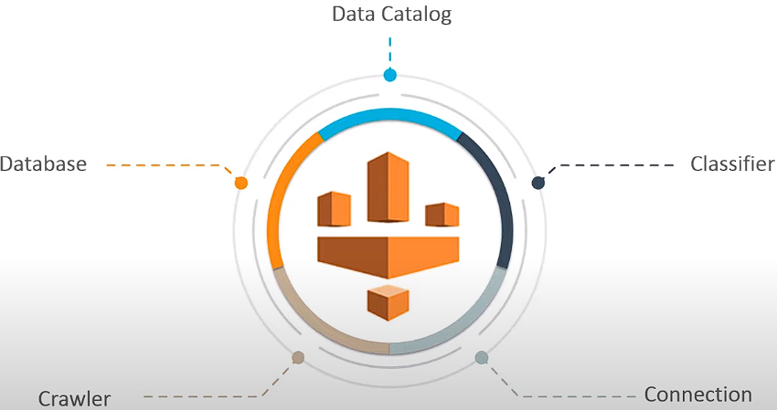
AWS Glue Terminologies
Data Catalog | Central place for storing our data schemas, table definition. It contains table definitions, job definitions, and other control information to manage your AWS Glue environment.
Classifier | Determines the schema of your data. AWS Glue provides classifiers for common file types, such as CSV, JSON, AVRO, XML, and others.
Connection | A Data Catalog object that contains the properties that are required to connect to a particular data store.
Crawler | A program that connects to a data store (source or target), progresses through a prioritized list of classifiers to determine the schema for your data, and then creates metadata tables in the AWS Glue Data Catalog. A tool which can automatically create table definitions in the data catalog
Database | A set of associated Data Catalog table definitions organized into a logical group.

Slide 4
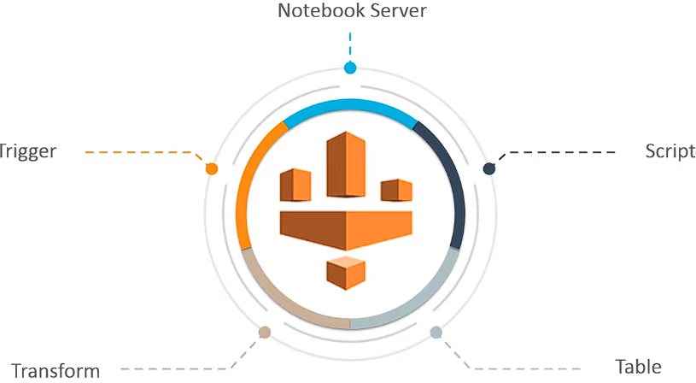
AWS Glue Terminologies
Notebook server | A web-based environment that you can use to run your PySpark statements. PySpark is a Python dialect for ETL programming. You can set up a notebook server on a development endpoint to run PySpark statements with AWS Glue extensions.
Script | Code that extracts data from sources, transforms it, and loads it into targets. AWS Glue generates PySpark or Scala scripts.
Table | The metadata definition that represents your data. Whether your data is in an Amazon Simple Storage Service (Amazon S3) file, an Amazon Relational Database Service (Amazon RDS) table, or another set of data, a table defines the schema of your data
Transform | The code logic that is used to manipulate your data into a different format.
Trigger | Initiates an ETL job. Triggers can be defined based on a scheduled time or an event. To run jobs, it can be set to run on demand, or when an other job has finished successfully

Slide 5
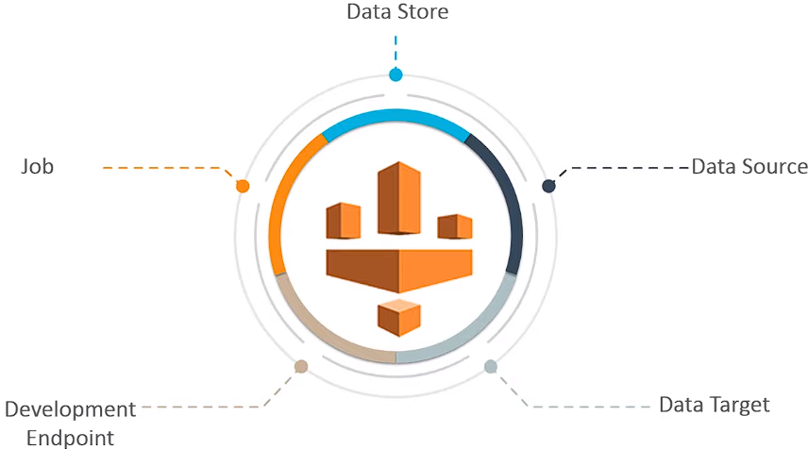
AWS Glue Terminologies
Data store | A data store is a repository for persistently storing your data. Examples include Amazon S3 buckets and relational databases.
Data source | A data source is a data store that is used as input to a process or transform.
Data target | A data target is a data store that a process or transform writes to.
Development endpoint | An environment that you can use to develop and test your AWS Glue ETL scripts.
Jobs | The business logic that is required to perform ETL work. It is composed of a transformation script. Script which does the data loading and transformation.

Slide 6
AWS Glue Components
Crawler | A program that connects to a data store (source or target), progresses through a prioritized list of classifiers to determine the schema for your data, and then creates metadata tables in the AWS Glue Data Catalog. A tool which can automatically create table definitions in the data catalog
Data Catalog | Central place for storing our data schemas, table definition. It contains table definitions, job definitions, and other control information to manage your AWS Glue environment.
Jobs | The business logic that is required to perform ETL work. It is composed of a transformation script. Script which does the data loading and transformation.
Script | Code that extracts data from sources, transforms it, and loads it into targets. AWS Glue generates PySpark or Scala scripts.
Trigger | Initiates an ETL job. Triggers can be defined based on a scheduled time or an event. To run jobs, it can be set to run on demand, or when an other job has finished successfully

Slide 7
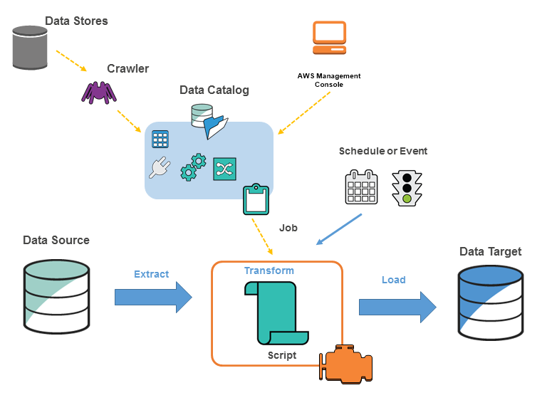
AWS Glue Concepts
The following diagram shows the architecture of an AWS Glue environment.

Slide 8
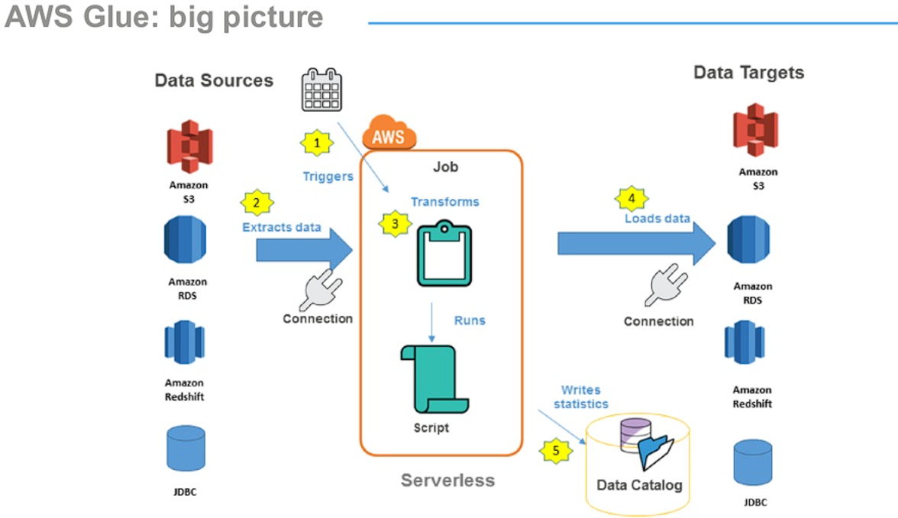
AWS Glue Understanding Data

Slide 9
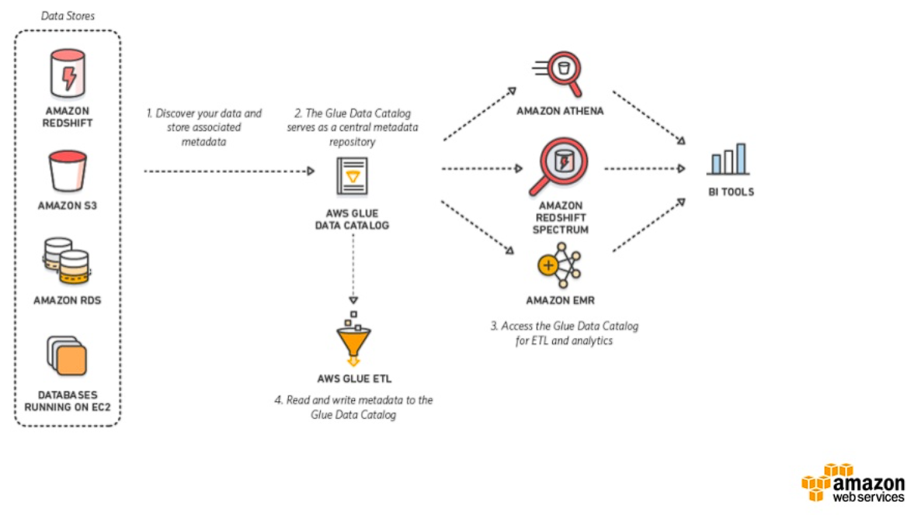
AWS Glue Understanding Data

Slide 11
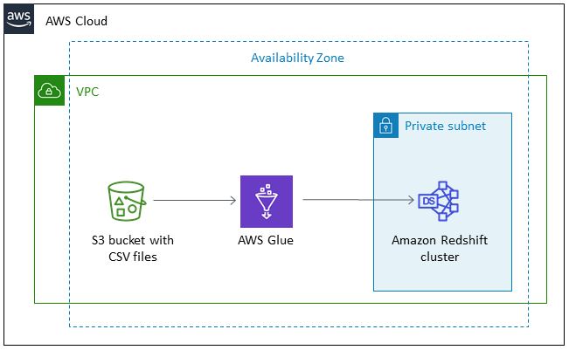
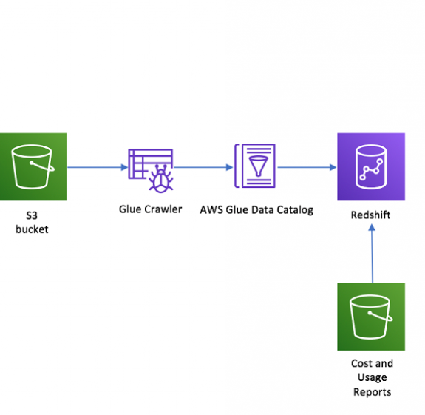
AWS Glue Transferring data from S3 to Redshift
Basic Architecture
This pattern describes the data migration process from an Amazon Simple Storage Service (Amazon S3) bucket to an Amazon Redshift cluster by using AWS Glue.
Implementation

Slide 12
Steps to Transferring data from S3 to Redshift
The data migration process from an Amazon Simple Storage Service (Amazon S3) bucket to an Amazon Redshift cluster by using AWS Glue.
Prerequisites
Before you begin, complete the following prerequisites:
An active AWS account.
We need an S3 bucket.
We must have the appropriate IAM permissions for Amazon Redshift to be able to access the S3 buckets – for this task, choose two non-restrictive IAM roles (AmazonS3FullAccess and AWSGlueConsoleFullAccess).

Slide 13
Steps
Prepare the target database
Create a Redshift cluster
Launch the Amazon Redshift cluster.
Create the database user for the migration in the Amazon Redshift cluster.
In VPC see the inbounds and outbounds carefully.
Create VPC endpoint select the endpoint as s3
Create a classifier
Add classifier name
Add the required classifier type

Slide 14
AWS Glue S3 to Redshift
Configuring an AWS Glue crawler
You can use an AWS Glue crawler to discover this dataset in your S3 bucket and create the table schemas in the Data Catalog. After you create these tables, you can query them directly from Amazon Redshift.
To configure your crawler to read S3 inventory files from your S3 bucket, complete the following steps:
Choose a crawler name.
Select the classifier we made.
Choose S3 as the data store and specify the S3 path up to the data
Choose an IAM role to read data from S3 and select glue as glue will be using the role – AmazonS3FullAccess and AWSGlueServiceRole and AmazonRedshiftFullAccess.
Set a frequency schedule for the crawler to run.
Configure the crawler’s output by selecting a database and adding a prefix (if any).
Run this crawler to add tables to your Glue Data Catalog.
After the crawler has completed successfully, go to the Tables section on your AWS Glue console to verify the table details and table metadata.

Slide 15
AWS Glue S3 to Redshift
Setting Up connection
Choose the connection name
Select connection type as Amazon Redshift.
Choose our defined cluster.
After this we would need to add our user name and password
Test the connection and choose the IAM Role
Configuring one more AWS Glue crawler(redshift crawler) (no need)
Define one more crawler this crawler will connect to the redshift database and will identify the schema of the table.
Choose a crawler name.
Choose JDBC as the data store and specify the connection.
Choose an IAM role to read data from S3 – AmazonS3FullAccess and AWSGlueConsoleFullAccess.
Set a frequency schedule for the crawler to run.
Configure the crawler’s output by selecting a database and adding a prefix (if any).
Run this crawler to add tables to your Glue Data Catalog.
After the crawler has completed successfully, go to the Tables section on your AWS Glue console to verify the table details and table metadata

Slide 16
AWS Glue S3 to Redshift
Now we need to set up Job
Create a new job set up name for the job in our case (transferring from s3 to redshift).
Choose the IAM role we created.
Select the type Spark.
Enable the job bookmark.(if we enable this it will remember what records were transferred already.)
Choose the data source first would be S3 table
Then for the target source select the JDBC connection and the the connection we made.
Click on Save job and edit script it would take us to a script where what transformations we want to do.
Run the job.
It would take upto 5 to 10 min
Go TO Redshift
In the editor table we can see the tables.

Slide 17
AWS Glue S3 to S3

Slide 18
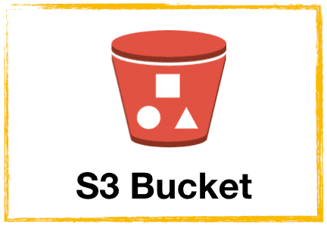

AWS Glue S3 to S3
This pattern describes the data migration process from an Amazon Simple Storage Service (Amazon S3) and doing some transformation and again writing it back to Amazon Simple Storage Service (Amazon S3 by using AWS Glue

Slide 19
AWS Glue S3 to S3
The data migration process from an Amazon Simple Storage Service (Amazon S3) and doing some transformation and again writing it back to Amazon Simple Storage Service (Amazon S3 by using AWS Glue).
First we need to create a bucket in S3.
Click on create bucket and provide appropriate Name and Region to the Bucket.
Create one folder in bucket.
Upload Files to the created folder in bucket.
Configuring an AWS Glue crawler
Choose a crawler name.
Choose S3 as the data store and specify the S3 path up to the data
Choose an IAM role to read data from S3 – AmazonS3FullAccess and AWSGlueConsoleFullAccess.
Set a frequency schedule for the crawler to run.
Configure the crawler’s output by selecting a database and adding a prefix (if any).
Run this crawler to add tables to your Glue Data Catalog.
After the crawler has completed successfully, go to the Tables section on your AWS Glue console to verify the table details and table metadata.

Slide 20
AWS Glue S3 to S3
Now we need to set up Job
Create a new job set up name for the job in our case (DEMO.JOB).
Choose the IAM role we created.
Select the type Spark.
Enable the job bookmark.(if we enable this it will remember what records were transferred already.)
Choose the data source and data target.
Click on Save job and edit script it would take us to a script where what transformations we want to do
Run the job.
It would take upto 5 to 10 min

